Slide 1
DishDelights: Journey to Delight
Presented By:
Rusha Manandhar

Slide 2
Introduction
revolutionary food recipe blog offering affordability, quality, and accessibility all in one place, as we redefine the way you cook and savor food.

Slide 3
Problem Statement
Navigational Complexity
Limited Dietary Options
Ingredient Availability
Lack of Interactivity

Slide 4
Objectives:
Enhance user experience with, diversify recipe Offerings, improve ingredient accessibility, and improve ingredient accessibility

Slide 5
Tools Used
Front-end | Back-end
HTML | PHP
CSS | Wordpress
Bootstrap

Slide 6
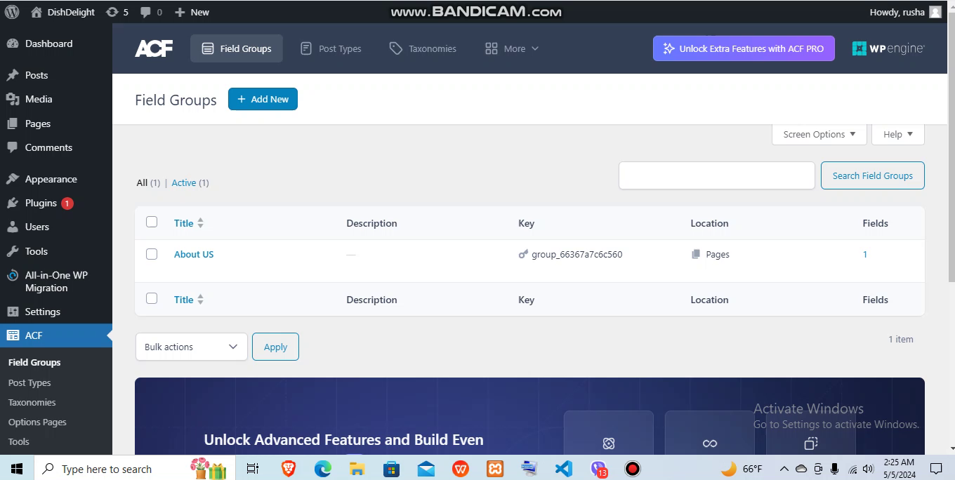
Website Overview

Slide 7
THANK YOU Any Queries?

